Slide 1
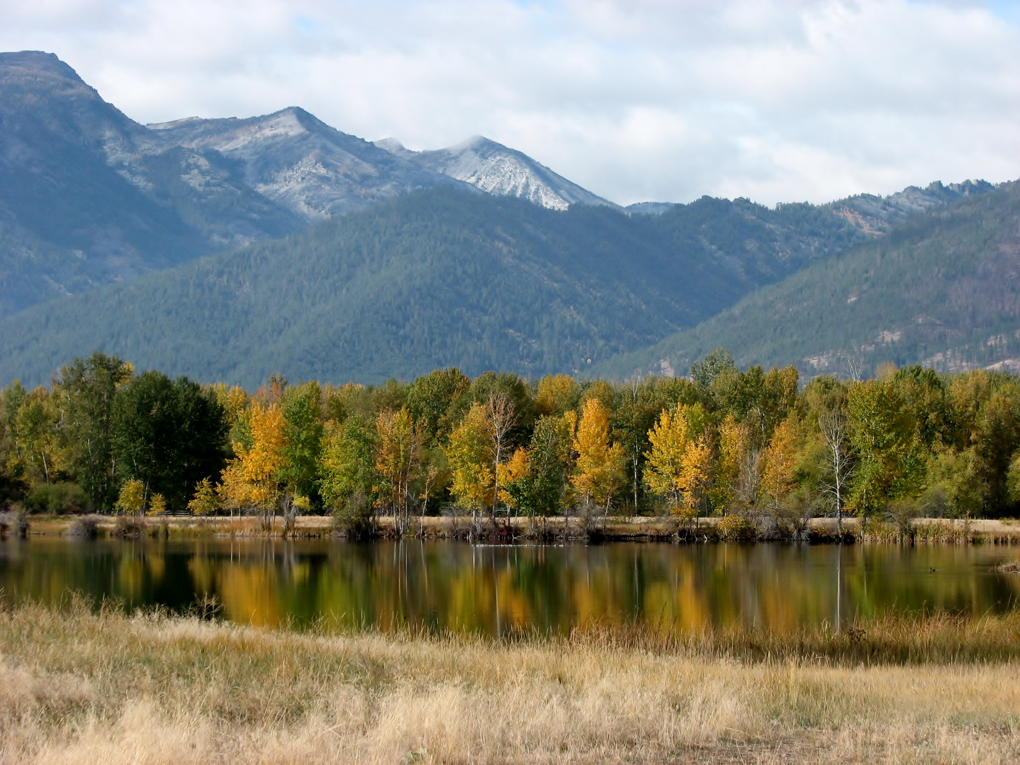
Partnering with Nonprofits/Agencies: Resources for Agriculture and Natural Resource Projects
Ravalli County Local Working Group
Ag Expo – January 9, 2016

Slide 2
Goals for today
Tell you about the Local Working Group
Let you know what resources and support are available locally
Make contact with interested landowners and producers

Slide 3
Ravalli County Local Working Group
Who we are:
We are a partnership of local citizens who share a strong interest in agriculture and natural resources.
Our Mission:
To work with agencies and the public to identify natural resource priorities in Ravalli County, and to facilitate collaborations to address these priorities.

Slide 4
RCLWG participants
Landowners and producers
Bitterroot Conservation District
Natural Resource and Conservation Service
Farm Services Agency
Bitter Root Land Trust
Bitter Root Water Forum
Bitter Root Resource Conservation and Development
Ravalli County Extension
US Forest Service
MSU Western Agricultural Research Center
Your input is important – please fill out our survey

Slide 5
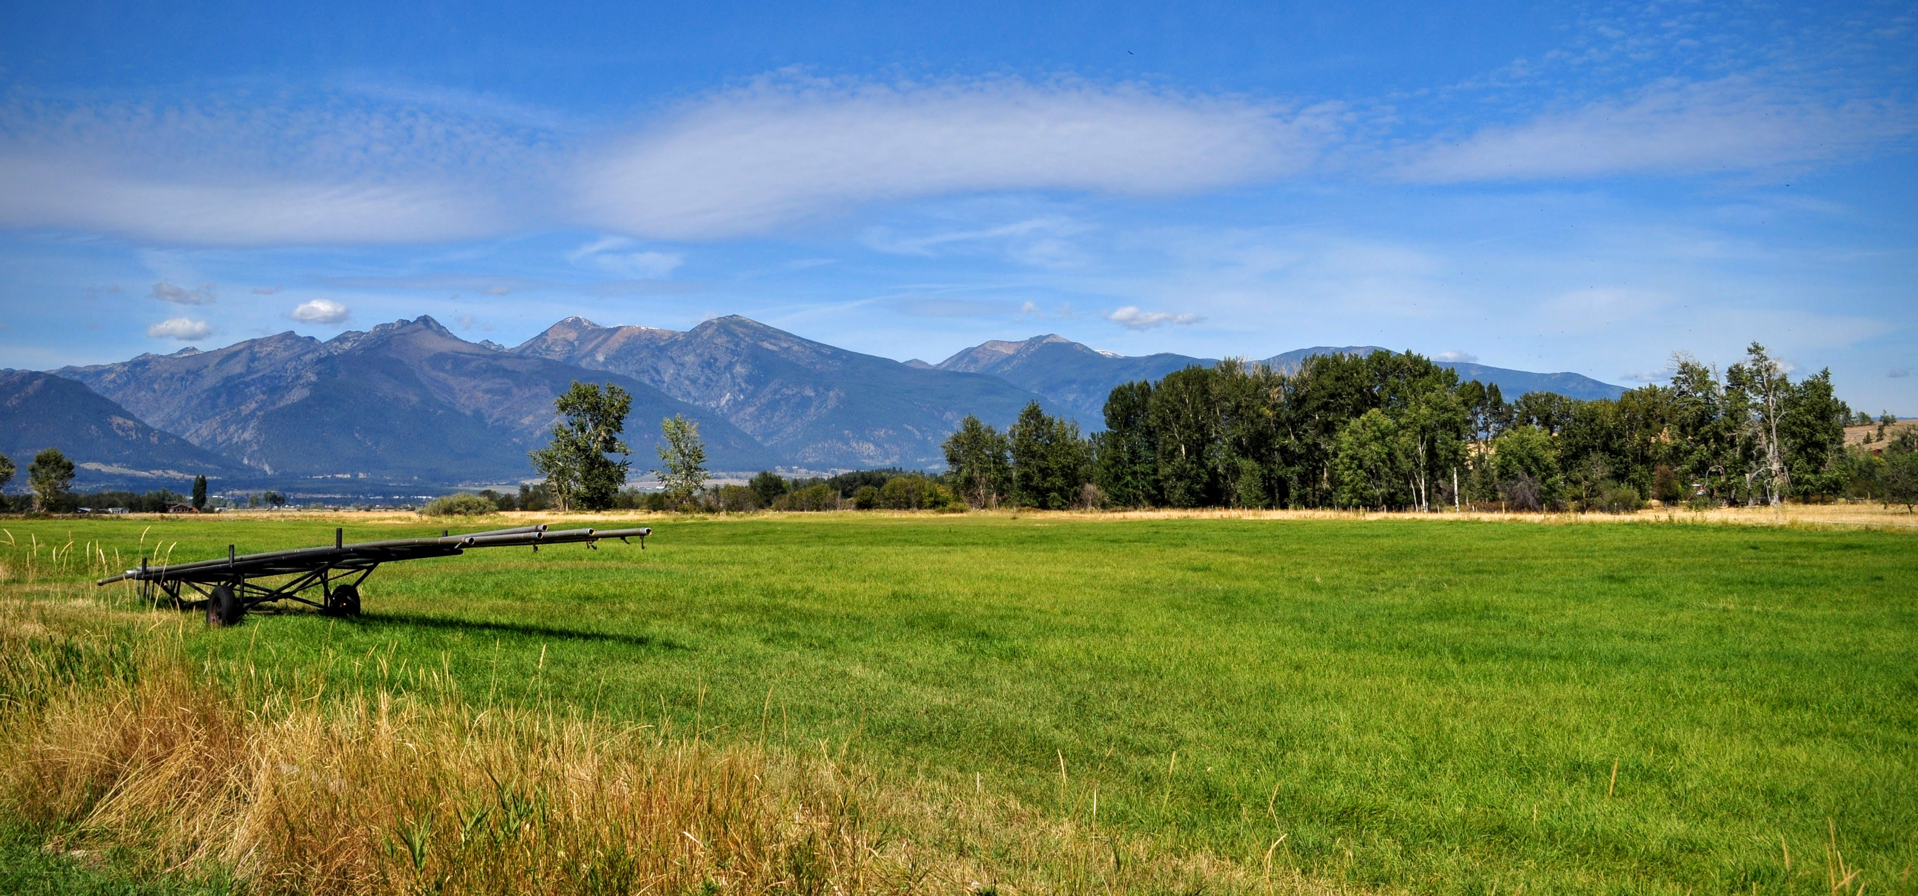
Presentations by agencies and non-profits
Bitterroot Conservation District
Natural Resource and Conservation Service
Farm Services Agency
Bitter Root Land Trust
Bitter Root Water Forum
Bitter Root Resource Conservation and Development
Photo credit: Grant Carlton, BRLT

Slide 6
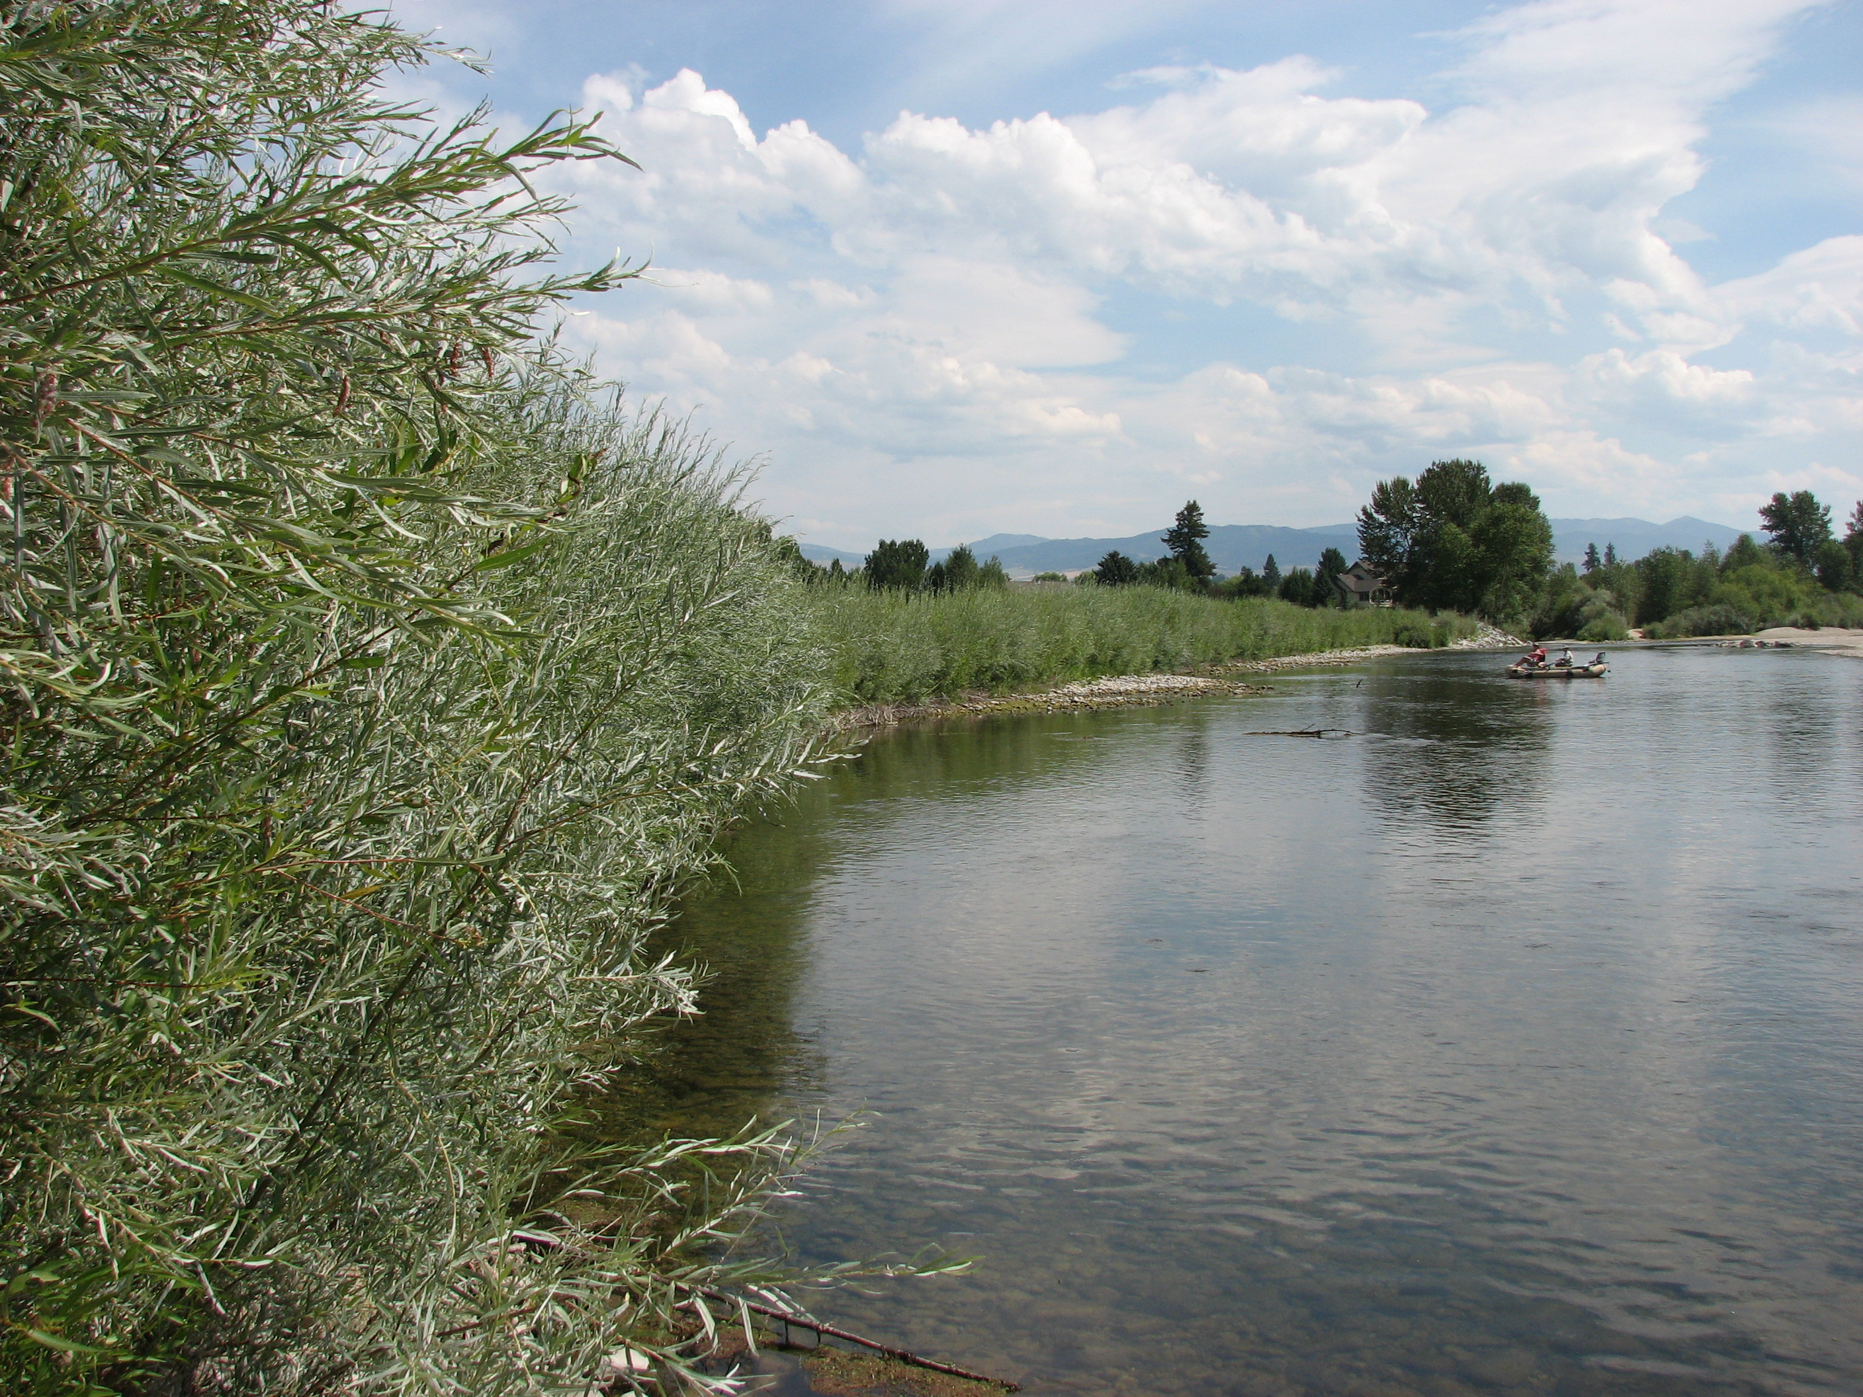
Bitterroot Conservation District

Slide 7
Services and support provided by the BCD
310 Permits
Cost share grants
Pass-through for state and federal grants
Collaboration on natural resource projects (e.g., Supply Diversion)
Education and outreach

Slide 8
310 Permits
1975 Natural Streambed and Land Preservation Act (“310 Law”)
Permit required for any project affecting a “natural perennial-flowing stream”
Projects can include bank stabilization, stream restoration, flood protection, stream crossings, and irrigation devices
Administered by the local Conservation District (BCD)
3-4 weeks typically required for permit approval

Slide 9
Cost share Grants
Eligible projects include habitat improvements (stream/fisheries, wildlife, upland), erosion control, weed management
Maximum award per project is $7,000 (no more than 70% of total project cost)
Application period is from July 1, 2016 to September 1, 2016, with contracts awarded in April 2017
For more information, please contact the BCD office (363-5010, ext. 101)

